Slide 1
Distributed Systems
分布式系统
Unix File Systems
Unix 文件系统

Slide 2
File Systems
File system provides the most fundamental service for building any information systems.
  file storage, management and retrieve service.
We look at two file operations:
fp = open (“cs4274/exam”, r, 0);
r = read (fp, n, buf);
memory
disk
buf
file
}n bytes

Slide 3
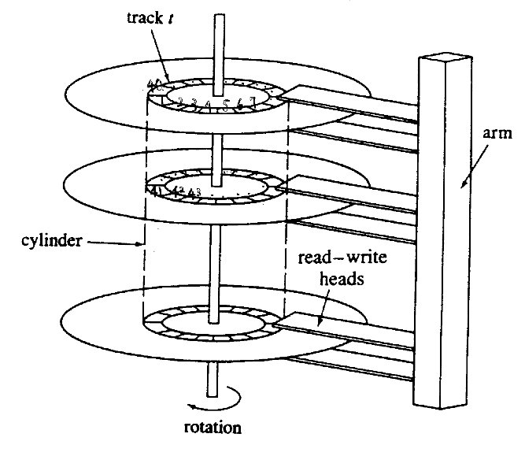
Hard disk Structure
Head, cylinder, sector
  Data stored in the same cylinder first to reduce the head movement
Disk operation in units of sectors
An IBM hard disk configuration:
10 heads
40 tracks-per-disk (cylinders)
32 sectors-per-track
512 bytes/sector

Slide 4
Data Block and Block Number
File system uses block as a data unit for disk operation
  Usually a block size is 1K (>= sector size)
  Disk block is referenced by its block #
Block # to Physical Address Translation
  sectors = blk_num × (#sects-per-blk)
  cyld_num = sectors ÷ (#sects-per-cyld)
  head_num = (sectors mod (#sects-per-cyld)) ÷ (#sects-per-track)
  sect_num = sectors mod (#sects-per-track)
0
1
2
3
4
5
2³²
●●●●●●●●●●●●

Slide 5
Internal File Structure
Each file has an i-node: file attributes and data index:
File attributes:
  owner, access permissions, access times, file size
  12 bytes
Data index:
  13 indices: 10 direct indices, 1 indirect index, 1 double indirect index, 1 triple indirect index
  13 * 4 =52 bytes
The size of an inode = 64 bytes.
An inode is referenced by its inode #

Slide 6
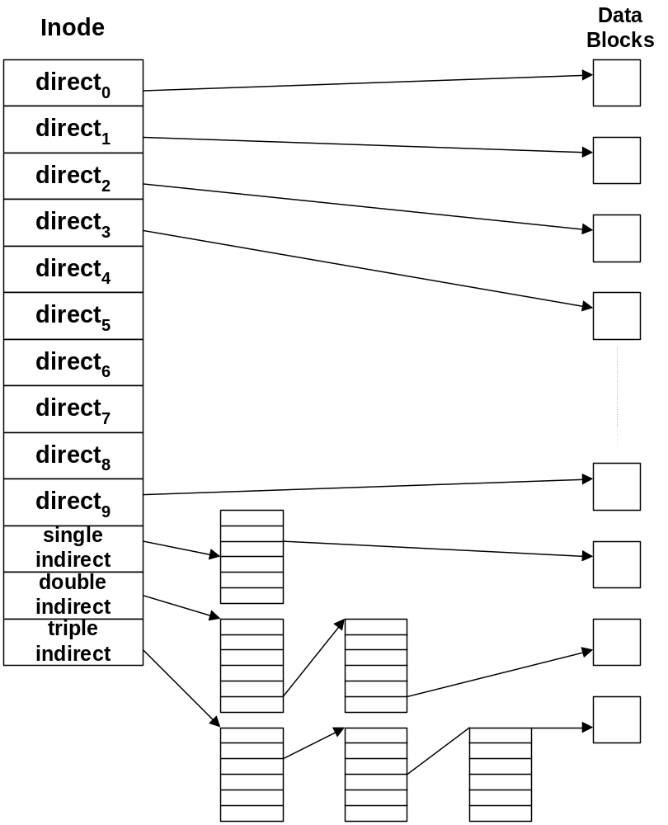
Diagram of data index in inode

Slide 7
Unix Directory File
Directory files are ordinary files consisting of entries mapping names to i-node #, e.g., directory file /etc
After BSD4.3, file names are of variable length (upto 255 bytes). Each entry has the entry-length, name & inode #.
Inode Number (2 bytes) | File Names (14 bytes)
83 | .
2 | ..
1798 | init
1276 | fsck
85 | clri
1268 | motd
1799 | mount
88 | mknod

Slide 8
Directory structure and name resolution
Directories are in a tree structure.
Resolve pathname recursively to i-node number, component by component from the root (or relative) directory, e.g. /home/lec/jia/unix-fs.doc
  a) Starting from inode # 3 of “/” → load inode of “/”
  b) Read content of directory file “/”:
  1368 bin@ 1478 lib/ 233756 rpool/ 2484 boot/ 1486 mnt/
  1489 sbin/ 1369 dev/ 154559 net/ 1494 system/ 2818 devices/
  6 export/ 2429 platform/ 5 var/ 27376 home/ ………………….
  c) Map “home” → inode # 27376 → load inode 27376
  d) Read directory file “/home”:
  94171 bsft08/ 93753 course/ 231 lec/ 94363 ms10/
  55531 bsft09/ 94125 cslab/ 94239 misc/ 91159 ms11/ ……
  e) Map “lec” → inode # 231 → load inode 231
  d) Repeat the above steps until map “unix-fs.doc” → inode #

Slide 9
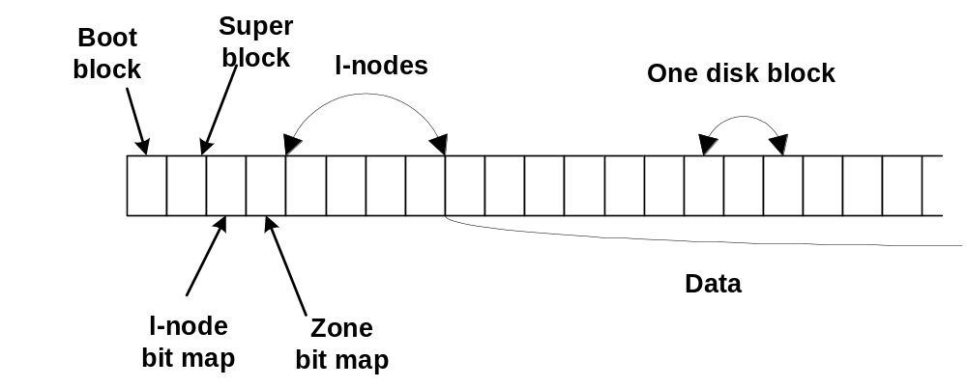
Disk Management
(inode # → i-nodes)

Slide 10
Super block 超级块
Each file system has a super block which contains:
  The size of the file system
  The number of free blocks in the system
  An array of cached free block numbers
  The index of the next free block number
  A pointer to the start of i-nodes area
  The number of free i-nodes in the system
  A list of cached free i-node numbers
  The index of the next free i-node numbers
The super block (usually one disk block) of the root file system must be loaded into memory when system is up.

Slide 11
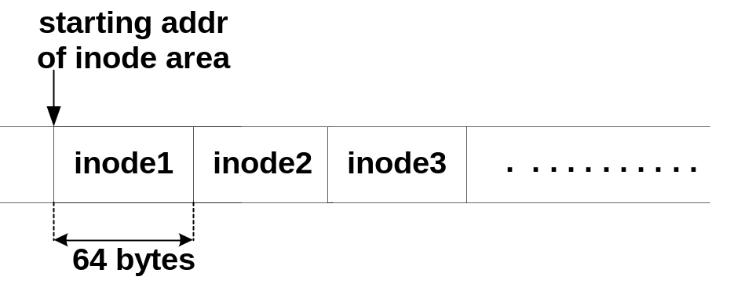
Calculate an inode address by inode number
blk_num = (inode_num −1) ÷ #inodes-per-blk + st-addr-inodes
byte_offset = ((inode_num −1) mod (#inodes-per-blk))×inode-size
N.B. In UNIX, inode-size = 64, #inodes-per-blk = 16

Slide 12
Summary on address translations
pathname → inode #
→ inode address (block # & offset)
→ inode
→ data block #
→ disk address
→ data

Slide 13
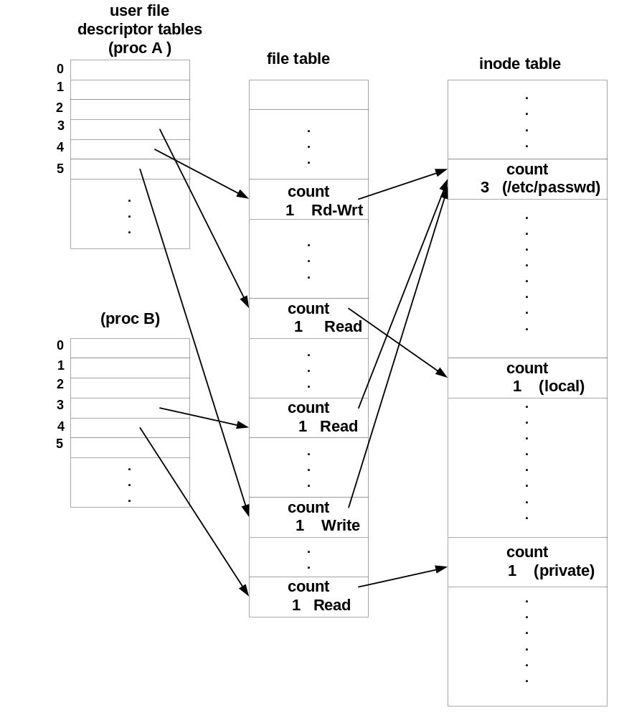
Internal Structure for File Accesses

Slide 14
Pseudo-code for open operation
  int open (path-name, op) {
  i = resolve(path-name);
  if inode(i) in inode-table then
  inode-table(i).count++;
  else
  load inode(i) into inode-table;
  create an entry in file-table, file-entry(i);
  file-entry(i).count = 1; file-entry(i).op = op; file-entry(i).offset = 0;
  file-entry(i).inode-ptr = &(inode-table(i));
  fd = get the next entry in file-descript-table, fdt;
  fdt[fd] = &(file-entry(i));
  return fd;
  }

Slide 15
Pseudo-code for read operation
  Steps of reading a file data:
  read (fp, n, buf)
  fp → pointer to the entry in file-table, getting offset
  → pointer to the entry in inode-table
  → get the block # of the data
  → convert the block # to head, cylinder, sector
  → ask disk controller to read in data and copy the n bytes into buf

Slide 16
Global File Organization
Disk Partitions
  disk units are partitioned into sections.
  each section is configured into a file system.
  inode numbers and disk block numbers are valid within a file system.

Slide 17
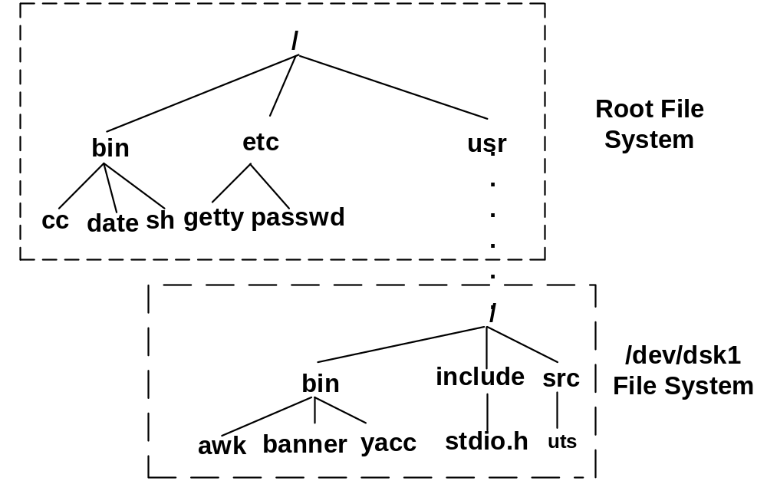
Mount/umount operations
mount(dev_name, dir_name, options); umount(dev_name)
e.g., mount(“/dev/dsk1”, “/usr”, 0)
/usr/src/uts

Slide 18
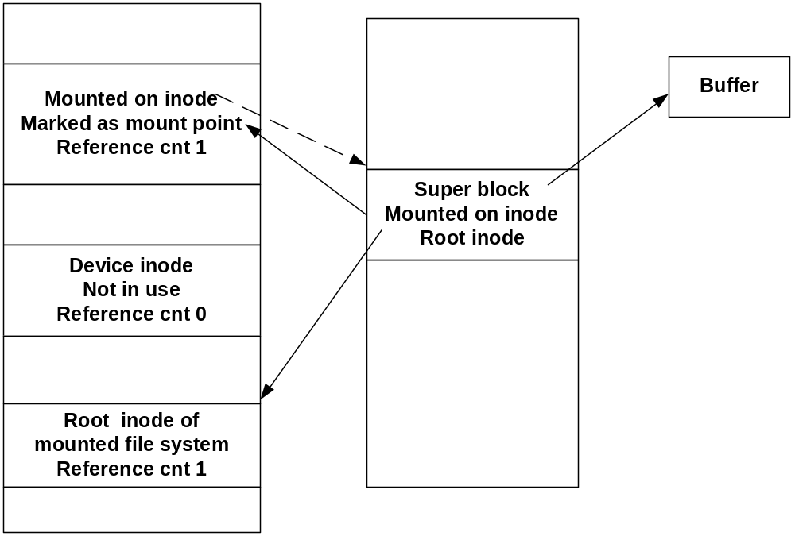
Mount table
incore inode table
mount table

Slide 19
Name resolution cross mount point
  mount /dev/dsk1 /usr
  cd /usr/src/uts
When the kernel parses the path name crossing a mount point, from the inode it knows this is a mount point.
It finds the mount table entry, which contains the addr of the super block and a pointer to the root inode (incore).
It then accesses the root inode of the mounted file system. The rest of the name resolution is inside the mounted fs.

Slide 20
Link files
Link system call is
link(sour_fname, dest_fname)
e.g. link(“usr/src/uts/sys”, “/usr/include/sys”)
File system first finds the inode # of the source file.
It then searches for the parent directory of the dest_fname.
It adds an entry in the parent directory of the dest file), and fills in the pair of dest_fname and the inode #.
Notice: link cannot cross a file system.

Slide 21
Distributed Systems
Distributed File Systems

Slide 22
DFS Goals
Location transparency: a uniform file name space that does not contain file physical location information.
Concurrency transparency: a user’s file operations will not be interfered by another user.
Failure transparency: when part of the system fails, the rest of the system can still provide file services.
Heterogeneity: interoperable among different operating systems and communication protocols.
Scalability: the system performance will not deteriorate as the system size grows.

Slide 23
Distributed File System Components
Flat file service: offer a simple set of general operations to access attributes and data of files, indexed by UFIDs.
Directory service: map text names to UFIDs.
Client module: allow access to file & directory service under a single application programming interface.
Client computer
Server computer
Application
Application
Directory service
program
program
Flat file service
Client module

Slide 24
Distributed File System Interface
Lookup
AddName
UnName
GetNames
Client computer
Server computer
Directory service
目录服务
Application
Application
program
program
Flat file service
平面文件服务
Client module
客户模块
Read
Write
Create
Delete
GetAttributes
SetAttributes
*

Slide 25
Flat file service operations
read(UFID, i, n) → Data
If 1 ≤ i ≤ Length(File), read a sequence of up to n items
—
throws
BadPosition
from a file starting at item i and returns it in Data.
write(UFID, i, Data)
If 1 ≤ i ≤ Length(File)+1, write a sequence of Data to a
—
throws
BadPosition
file, starting at item i.
create() → UFID
Create a new file with length 0 and return its UFID.
delete(UFID)
Remove the file from the file store.
getAttributes(UFID) → Attr
Return attributes of the file.
setAttributes(UFID, Attr)
Set file attributes.

Slide 26
Directory service operations
Lookup(Dir, Name) → UFID
Locate the text name in the directory and return the
—
throws
NotFound
relevant UFID. If Name is not in the directory, throw an
exception.
AddName(Dir, Name, UFID)
If Name is not in the directory, add (Name, UFID) to the
—
throws
NameDuplicate
directory and update the file’s attribute record.
If Name is already in the directory, throw an exception.
UnName(Dir, Name)
If Name is in the directory, the entry containing Name is
—
throws
NotFound
removed from the directory.
If Name is not in the directory, throw an exception.
GetNames(Dir, Pattern) → NameSeq
Return all the text names in the directory that match the
regular expression Pattern.

Slide 27
Constructing a Hierarchical FS at Client Module
A hierarchical file naming system can be constructed by the client module by using file & directory services.
The root of the directory tree is a directory with a well-known UFID.
A pathname resolution function is provided in the client module.

Slide 28
Differences between DFS and stand-alone FS
Separation of file service and directory service:
  The file service is made more general and the design of directory service can be more flexible.
  It off loads directory service from file server.
Stateless servers and emulations in the client module:
  File server is made very light weighted, leaving most of work to the client module.
  Server can recover from failure efficiently, with no need to restore client’s states.
  Client module emulates the traditional FS interface.
Repeatable operations
  File operations are idempotent, allowing the use of at-least-once RPC semantics.
  Operation create is exceptional (but no side-effect to users).

Slide 29
Capabilities and Access Control
Clients interacts with dir-server and file-server via RPCs. There is a security loophole, allowing unauthorized user to use other’s ID to access files illegally.
Capability (in the form of a UFID) is a digital key used to identify and access file by clients in distributed FS.
A capability includes information of file location (groupID), FID, and access control.
48 bits | 32bits | 32bits | 16bits
File group ID | File number | Encrypted permission + random number | Unencrypted permission

Slide 30
Capabilities and Access Control
Directory server generates the capability of a file based on to client’s ID and access permission.
Capabilities is used for access control to the file.
A capability must have an encrypted field to prevent it from being modified or mis-used by others. The encryption key is usually shared between the directory server and file server.

Slide 31
File Representation
An index block (similar to i-node in UNIX) is used for each file to point to data blocks (or another layer of index blocks).
Locating an index block is done by using UFID. The UFIDs can be organized to B-tree structure for efficient search.
  The mappings from UFIDs to the corresponding index-blocks are stored in disk, and the mappings can be too big to be in memory at once.
Server’s location (file group ID) is embedded in UFID. The client needs to know server’s location before making RPC for file access. This can be done by the following RPC to any server:
  PortID = GetServerPort(FileGroupID)

Slide 32
Space Leaks
Some files whose directory links have been removed may remain in disk and never be accessed, due to the separation of directory servers from file servers.
The problem is ignored, or prevented in most of the systems.
A “life-time” method aims to solve the problem:
  the dir-server periodically touch all files, i.e., set a life-time to all files registered with the directory-server.
  file-server decrements the life-time of all files at some clock rate, and each access to a file will renew its lifetime.
  The files with life-time 0 will be removed (they are not accessed).

Slide 33
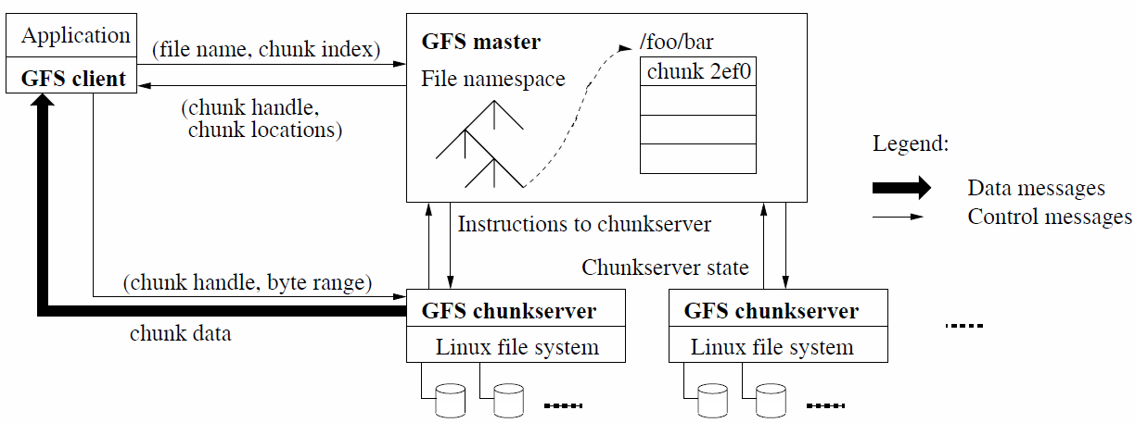
Google File System (an example)
GFS aims to provide fault-tolerant and highly concurrent accesses to huge files. It consists of GFS client, a single GFS master, and many GFS chunkservers.
The client requests the master (directory server) with file-name and chunk index (translated from user’s byte-offset within a file and the fixed chunk size, 64MB).
The master replies with the chunk handle and location of the replicas.
The client requests one of the replicas (chunkserver, i.e., data server) with chunk handle and a byte-range within the chunk for data-access.

Slide 34
Sun Network File System (NFS)
The Network File System (NFS) was developed to allow machines to mount a local directory to a remote file system as if it were on a local disk. It facilitates fast and seamless sharing of files across a network.
It is an open standard with clear and simple interfaces (an industry standard for file sharing in LANs since 1980s).
It follows the abstract file service model defined for Distributed File Systems.

Slide 35
NFS server operations (RFC1813, 1995)
read(fh, offset, count) → attr, data
write(fh, offset, count, data) → attr
create(dirfh, name, attr) → newfh, attr
remove(dirfh, name) status
getattr(fh) → attr
setattr(fh, attr) → attr
lookup(dirfh, name) → fh, attr
rename(dirfh, name, todirfh, toname)
link(newdirfh, newname, dirfh, name)
readdir(dirfh, cookie, count) → entries
symlink(newdirfh, newname, string) → status
readlink(fh) → string
mkdir(dirfh, name, attr) → newfh, attr
rmdir(dirfh, name) → status
statfs(fh) → fsstats
Modelling flat file service
Read(FileId, i, n) → Data
Write(FileId, i, Data)
Create() → FileId
Delete(FileId)
GetAttributes(FileId) → Attr
SetAttributes(FileId, Attr)
Modelling directory service
Lookup(Dir, Name) → FileId
AddName(Dir, Name, File)
UnName(Dir, Name)
GetNames(Dir, Pattern)
→ NameSeq
*

Slide 36
NFS architecture
Client computer
Server computer
Application
Application
program
program
UNIX
system calls
UNIX kernel
UNIX kernel
Virtual file system
Virtual file system
Local
Remote
UNIX
Other
file system
NFS
NFS
UNIX
file
client
server
file
system
system
NFS
protocol

Slide 37
NFS Structure
NFS client module resides in the UNIX kernel. It emulates exactly the semantics of UNIX file system.
  application programs can run in NFS without any change.
  a single client module serves all user processes.
NFS client and server modules communicate using NFS protocol and mount protocol (through Sun RPCs).
NFS server is stateless. It provides reliable file operations.

Slide 38
NFS Virtual File System
NFS introduces a Virtual File System (VFS) layer. It maintains an entry of v-node (virtual i-node) for each file that is currently opened or mounted.
v-node is a data structure maintained in OS (similar to incore inode-table in unix), not stored on disk. It indicates whether a file is local or remote.
  For a local file, it contains i-node.
  For a remote file, it contains the file-handle as following:
FileSystem ID | i-node number | i-node generation number

Slide 39
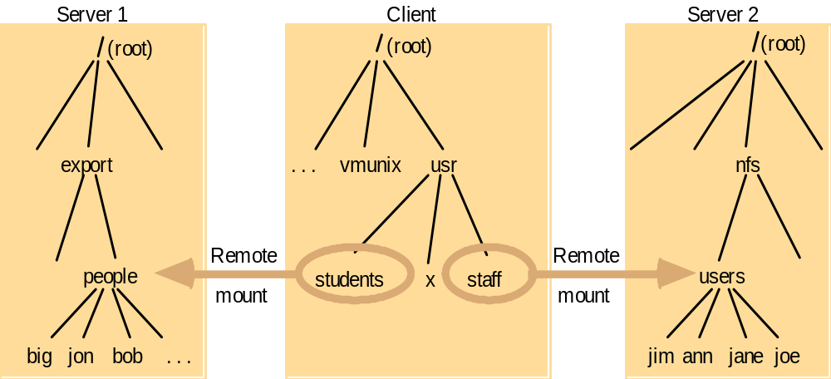
Mount remote file systems to client in NFS
Note: The file system mounted at /usr/students in Client is a sub-tree located at /export/people in Server 1;
The file system mounted at /usr/staff in Client is the sub-tree located at /nfs/users in Server 2.

Slide 40
Mount Service
Each NFS server runs a mount process at application level.
Client module requests mount of a remote file system by specifying remote host name, pathname and local directory to be mounted.
The mount process at the server communicates with the client by a mount protocol (RPCs), and returns the file-handle of the mounted directory to the client.
The client keeps the file-handle (containing location of the server) in the v-node of the mounted directory for subsequent file accesses.

Slide 41
File Sharing (export for mount): by server
share [-F FSType] [-o specific_options] [-d description] [pathname]
dfshares [-F FSType] [-h] [-o specific_options] [server...]
share: export, or make a resource available for mounting, through a type specified FSType, or the first file-system-type listed in /etc/dfs/fstypes file.
  /etc/dfs/fstypes: list of DFS utilities installed on the system. For each installed DFS type, there is a line starting with file system type (e.g., “nfs” or “autofs”), followed by descriptive text.
  /etc/dfs/dfstab: list of share commands to be executed at boot time
  /etc/dfs/sharetab: system record of shared file systems
dfshares: list available resources from remote or local systems
  For each resource, the fields are: resource server access transport

Slide 42
Mount Remote Files: by client
mount [ -F nfs] [generic_options] [-o specific_options] [-O] resource mount_point
mountall [-F FSType] [-l | -r] [file_system_table]
The mount process attaches a named directory to the file system hierarchy at the pathname location mount_point.
/etc/vfstab: list of default parameters for each file system.
  Each entry consists of space-separated fields:
    device to mount, device to fsck, mount point, FS type, fsck pass, mount at boot, mount options.
  Those file systems with the mount-at-boot field “yes” are mounted automatically at boot time by mountall
/etc/mnttab: a record of file systems that are currently mounted.
  Each entry consists of TAB-separated fields:
    special, mount_point, fstype, options, time

Slide 43
Automounting
automount [-t duration] [-v]
Problem with static mounts
  If a client has many remote resources mounted, boot-time can be excessive
Automount: Mount and unmount in response to client demand
  Automounter performs mount according to configuration files (/etc/auto_master, /etc/auto_home)
  When an empty mount point is referenced,
    OS sends a probe message to each server
    First reply wins: then uses the mount service to mount the filesystem at the first server to respond
  Attempt to unmount every 10 minutes
Automounter (/usr/lib/autofs/automountd) is started at system boot-up time, and is a daemon process running at the client computer

